Slide 1
CHALLENGES TO CHANGE
Climate Justice in BC: Lessons for Transformation
www.teachclimatejustice.ca

Slide 2
Types of change
Personal change – changes you can make in your own behavior to address climate change and reduce greenhouse gas emissions.
Systemic change – changes in systems or our environment that address the underlying causes of climate change and high greenhouse gas emissions.

Slide 3
Brainstorm as a class
What are some examples of successful change movements through history?
Questions:
Why do you think these change movements were successful?
What are some of the obstacles and challenges the movements faced and overcame?

Slide 4
The Story of Change – Guiding questions
What do you think are the biggest challenges to change?
What do you think people need to do to make lasting change in the world?

Slide 5
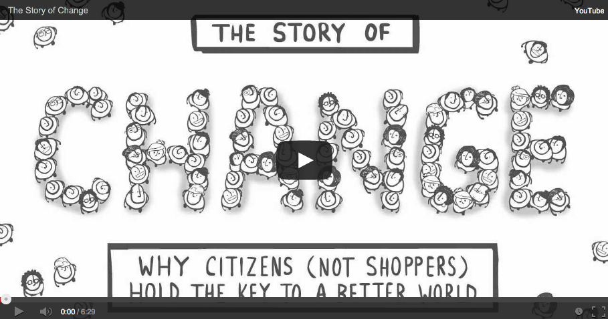
The Story of Change
Notes:
http://storyofstuff.org/movies/story-of-change/

Slide 6
How do we make change happen?
How much popular support do you think the average social change movement needs to make meaningful, widespread change actually happen?
At the time of Martin Luther King Jr.’s march on Washington, only 23% of Americans supported him.

Slide 7
Support for climate action in BC
What percentage of people in BC do you think support climate action initiatives for the province, such as investments in public transportation, transition programs for workers in fossil fuel industries, and subsidies for home and building retrofits?
It’s around 80% to 95%!
86% of people in BC believe climate action will be good for people and the province regardless of whether they think climate change is a serious threat
89% agree that “Canadians as a whole will be better off if we can be less dependent on fossil fuels”

Slide 8
Support for climate action in BC
As we saw in The Story of Change video, this means we have the numbers to make real positive change in BC around climate justice if we:
are guided by a BIG IDEA
work TOGETHER
take ACTION to change SYSTEMS

Slide 9
Changing policies and systems
What are some systemic changes we could make in BC that would help us move towards climate justice?

Slide 10
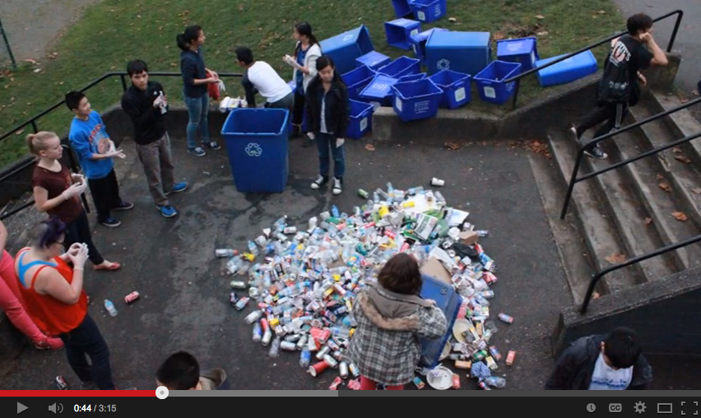
Youth4Tap at Windermere
Notes:
http://www.youtube.com/watch?v=k1idmn96ceY

Slide 11
Positive change is possible
What systems or policies in our school or community could we try to change in order to move towards climate justice?
What would be our big ideas?
Who would we network with in our communities?
What collective actions could we engage in to try to make change happen?

