Slide 1
RETHINKING WASTE
Climate Justice in BC: Lessons for Transformation
www.teachclimatejustice.ca

Slide 2
Looking at our garbage – Questions
How many of these items were purposely designed by humans to be thrown away (e.g. packaging, paper cups, etc.)?
What else in our home or school is “designed for the dump”?
What items do we recycle? How long are these items used before they are recycled?

Slide 3
What happens to our stuff after we throw it away?
Traditional “solutions” include landfills or incineration. Also, recycling and composting programs have become widespread over the past few decades.
Some governments are proposing increased incineration instead of landfilling. However, incineration does not make trash disappear – it releases toxic chemicals and GHGs into the air, and produces toxic ash, which must be landfilled.

Slide 4
What happens to our stuff after we throw it away?
Important note: the energy that went into extracting materials and transforming them into a product is lost when that product becomes waste.
Organic materials that go to landfill do not decompose in the same way as if they were composted, and they release methane, a very powerful greenhouse gas.
About 40% of food in Canada is wasted. About 25% is thrown out at home, and the rest is lost in production or transport.

Slide 5
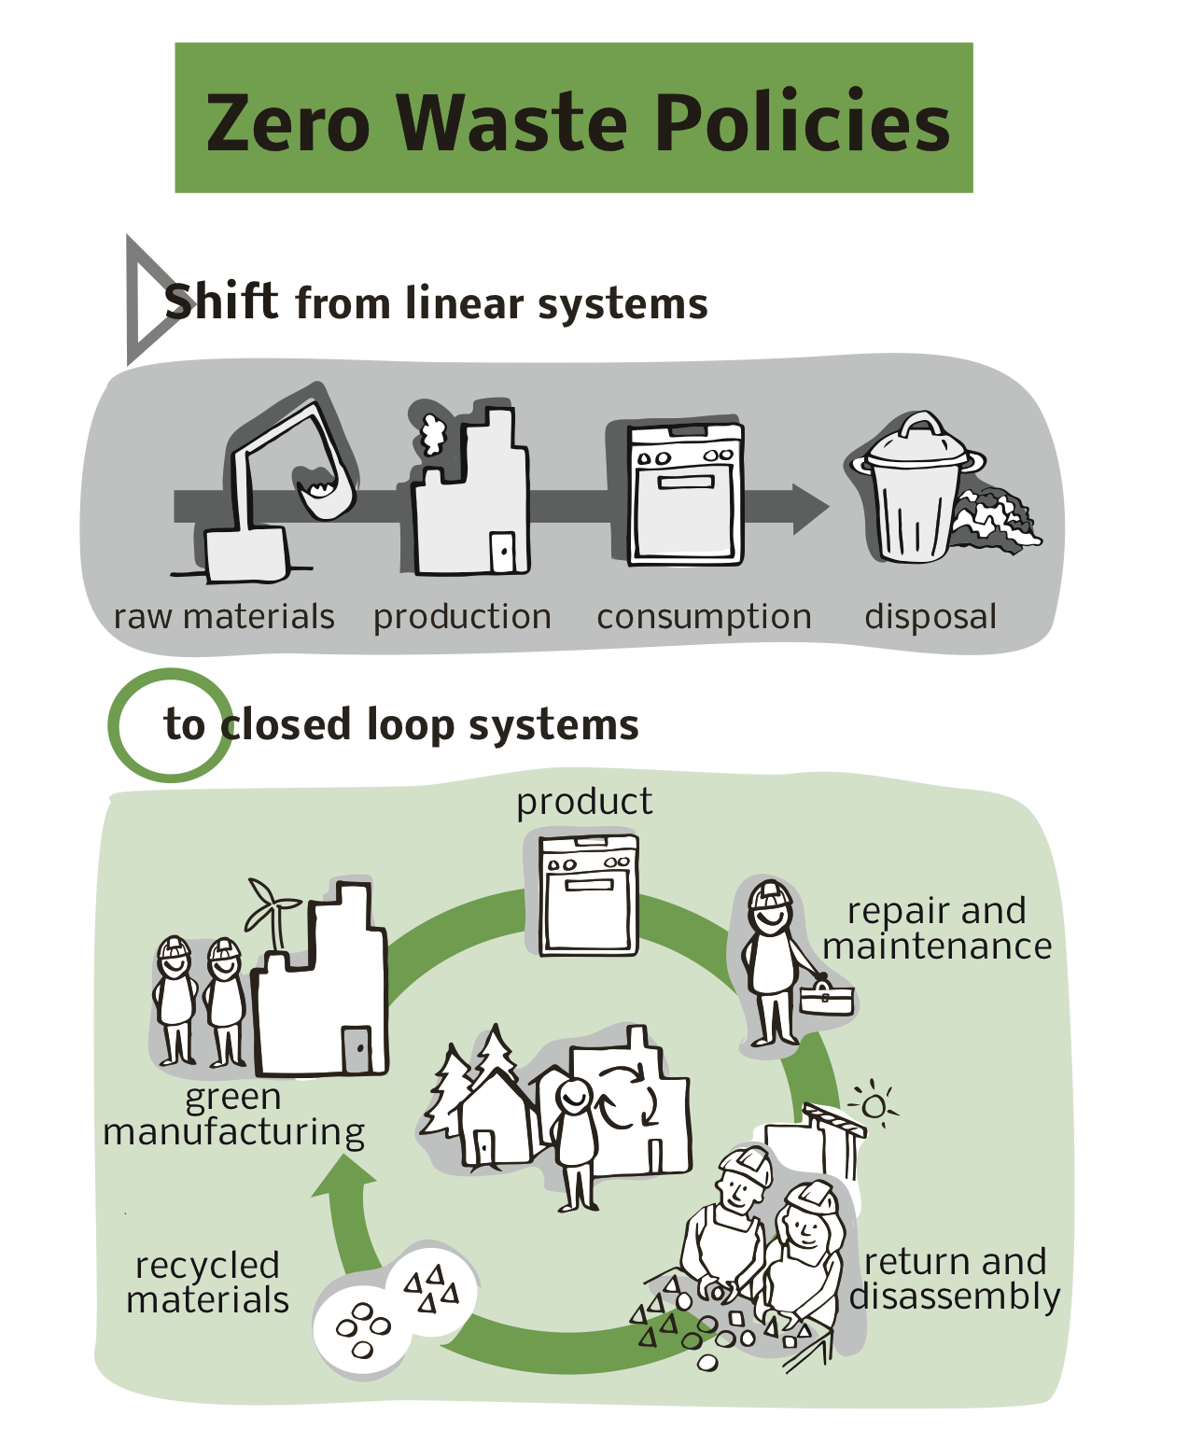
Illustration by
Sam Bradd

Slide 6
Illustration by
Sam Bradd

Slide 7
Activity: Redesign challenge
In groups of four, choose four human-made waste projects from the garbage list (created in Part 1).
The challenge: How would you redesign each product so the waste is eliminated? This could involve changing the materials in the product, creating a way for the product to be reused, or changing the broader systems involved.

